Slide 1
High-speed Interconnection System
Group member:
Yuan Yao Meng Lee
12/16/2014

Slide 2
Basic Concept
Our project is a part of Professor Sheldon Tan and Industry Advisor James Zhou’s research. There are many steps to complete this project: Concept -> Derivation -> Declaration -> Definition -> Integration -> Test and Validation -> Documentation -> Report -> Release
Our part in this research is Declaration and Definition. Therefore, our basic concept of our senior design is to implement a software design in order to improve the algorithms that industry currently uses.
Declaration is essentially building the structure of the signal we will be analyzing.
Definition is when we use new algorithms to calculate and compare results with existing work.
In the standpoint of the industry, our project is very practical.
serial link by three cascaded 4-port networks
network 1
network 2
network 2
Figure 1

Slide 3










Basic Concept cont.
Figure 2 shows the signal connection we are using. This is a noise canceling channel with Vso and –Vso.
$$V_{s0}$$
$${Z_{0}}_{}^{+}$$
$V_{1}I_{1}$ ⇨
$$\text{⇦} V_{2}I_{2}$$
$${Z_{0}}_{}^{r}$$
Z
1
2
3
4
$${−V}_{s0}$$
$${Z_{0}}_{}^{+}$$
$V_{2}I_{2}$⇨
$$\text{⇦} V_{4}I_{4}$$
$${Z_{0}}_{}^{r}$$
Figure 2

Slide 4
Technical design objectives
We have two subfields in this project: 1. Serial Link Analysis 2. Parallel Bus Analysis
Our technical objective is implementing a fully functional program that can be used to analyze these two types of signals.
Specifications:
Using MATLAB 2014a to complete declaration for both serial and parallel bus analysis.
Using MATLAB to complete definition.

Slide 5
High level design, show block diagram of the system

Slide 6
Technical challenges

Slide 7
Major tasks
Bit Source
Tx FFE
Tx AEQ
Tx Package
Passive link
Modulator
repeater
Passive link
Rx Package
Rx AEQ
Rx DFE
Sampler
CDR
Analog blocks are concatenated in frequency-domain to form a single block; Its impulse response is used for time-domain analysis.
Tx FFE and Rx DFE/CDR models are provided in IBIS AMI format.
Bit source, modulator and sampler are implemented in EDA tool.

Slide 8
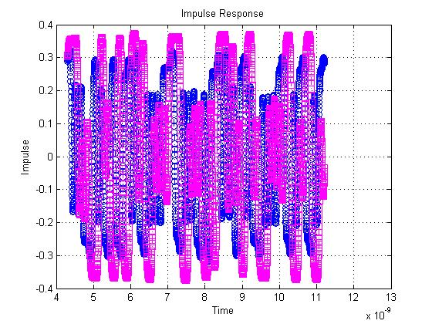
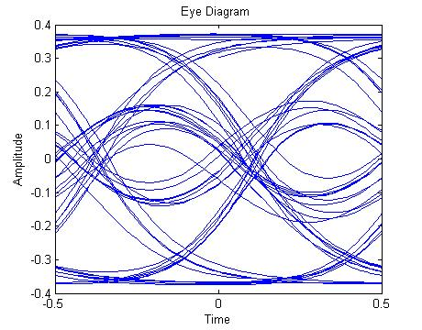

Slide 9
Design considerations

Slide 10
Summary

Slide 11
Acknowledgment
SLA and PBA have extensive application in electronics industry.
increase the stability and speed of existing algorithms
ability to streamline the workflow

